Slide 1
Safety: Coffee Machines
09/08/2026

Slide 2
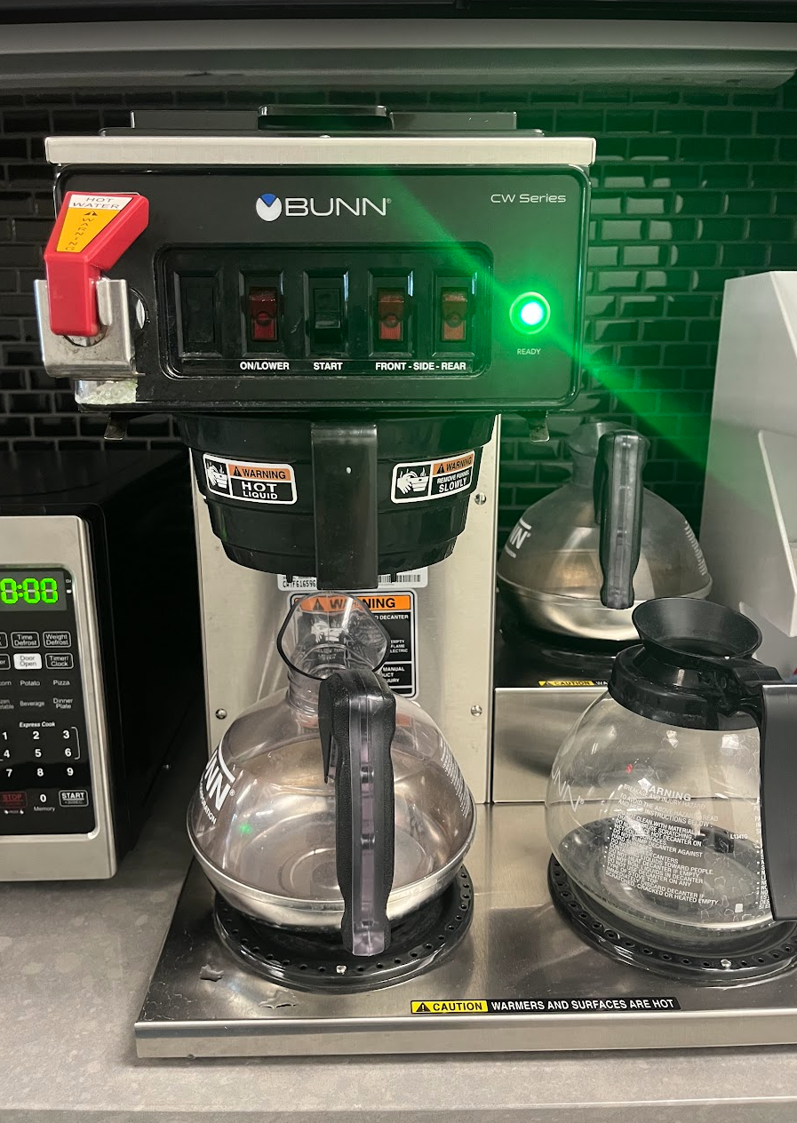
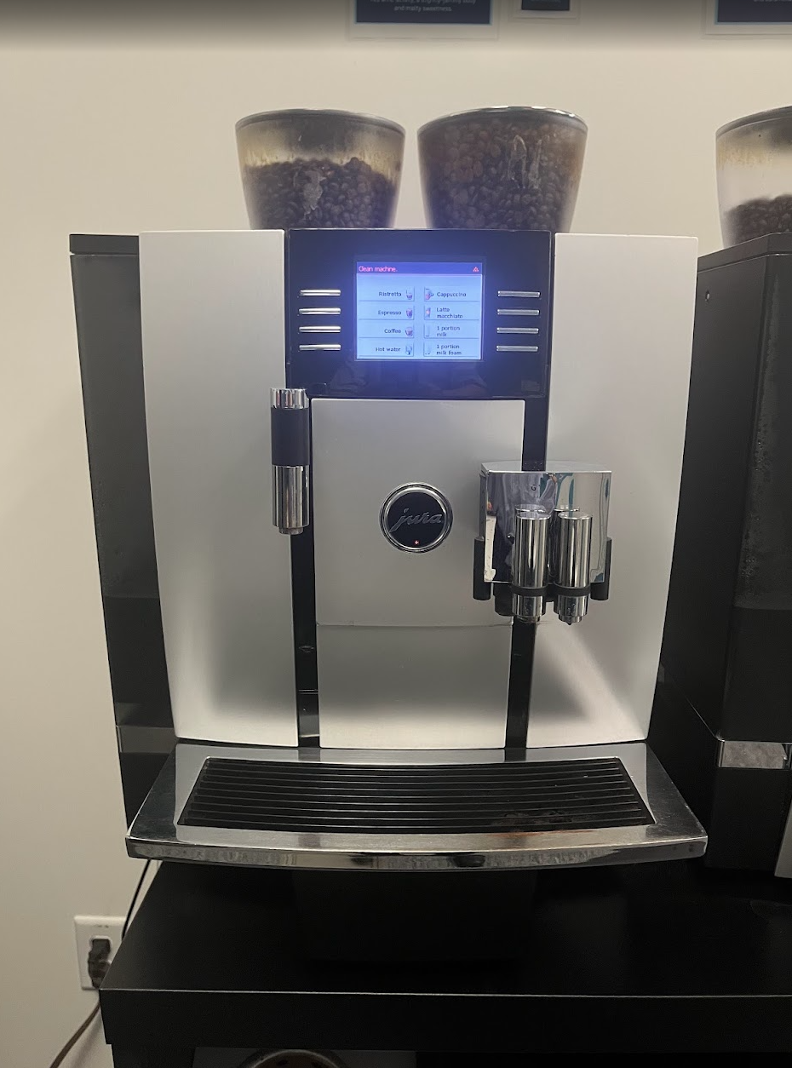
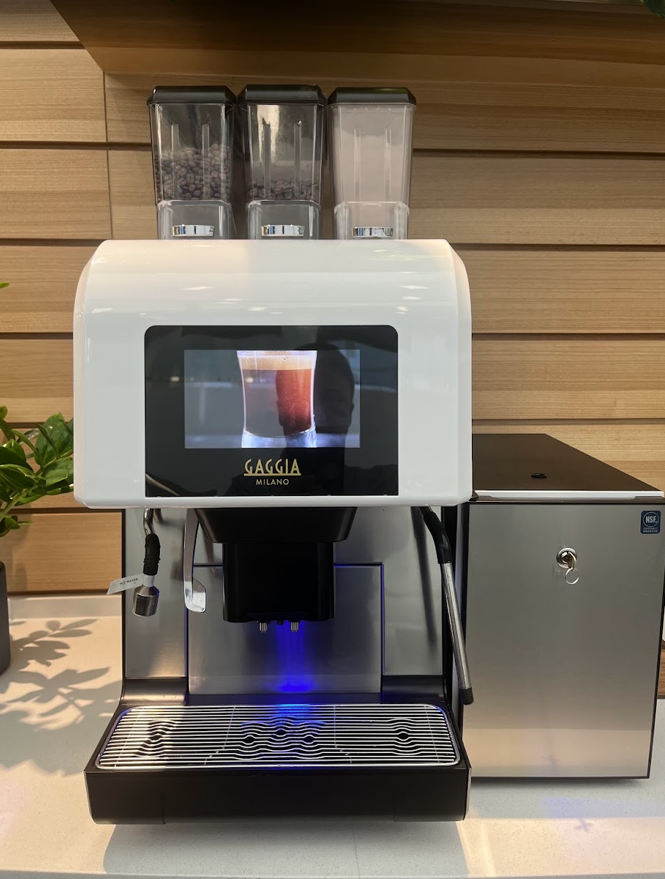
Safety

Slide 3
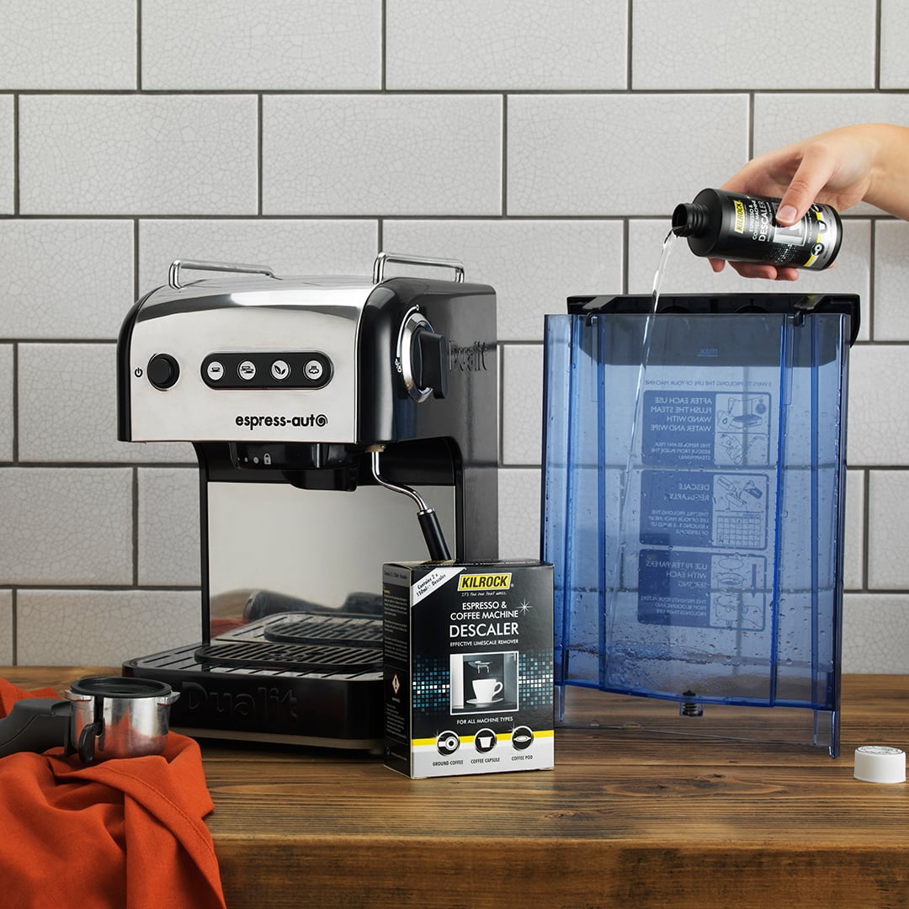
Key Safety Info
Every time you use your coffee machine make sure you follow these instructions!
Always turn off and unplug your coffee maker after use. This avoids any potential fire risk caused by a faulty appliance or faulty electrics
If you ever notice a burning smell, or your coffee maker starts to make an unusual noise unplug it immediately
Never use your coffee maker if it is damaged or cracked

Slide 4
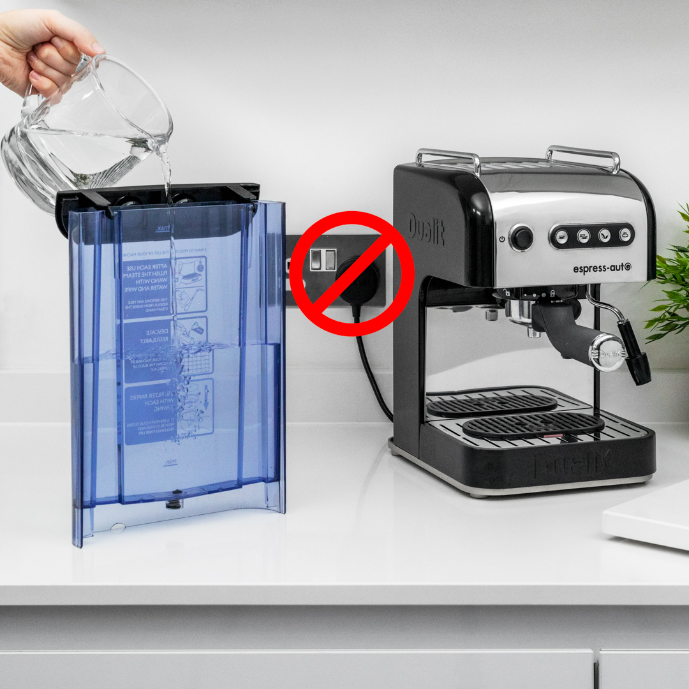
Before each use
Follow these steps to get your coffee machine ready to use.
Always unplug the coffee maker before filling the tank with water
Don't fill any coffee machine water tank with sparkling, hot or boiling water
With any coffee maker or accessory, don't fill the water tank or main unit past the 'MAX' indicator

Slide 5
Cleaning your coffee machine
Before cleaning, unplug your coffee machine and allow it to cool down
Never immerse the machine in water to clean; this could cause permanent damage
If coffee machine has a steam wand, rinse it through and wipe down after every use to avoid it becoming blocked with limescale or milk residue
Descale your coffee machine at least once a month in hard water areas or with daily use, or once every two months for soft water areas or when used less regularly (e.g. only on weekends or evenings).

Slide 6
Recalls
Watch for recalls due to electrical failures or other potential hazards

